Slide 1
The Latest Graphics Technology in Remedy's Northlight Engine
Tatu Aalto
Lead Graphics Programmer

Slide 2
The Latest Graphics Technology in Remedy's Northlight Engine
Tatu Aalto
Lead Graphics Programmer
Notes:
- welcome
- you might guess what I’m talking about

Slide 3
The Latest Graphics Technology in Remedy's Northlight Engine
Tatu Aalto
Lead Graphics Programmer

Slide 4
Experiments with DirectX Raytracing in Remedy's Northlight Engine
Tatu Aalto
Lead Graphics Programmer

Slide 5
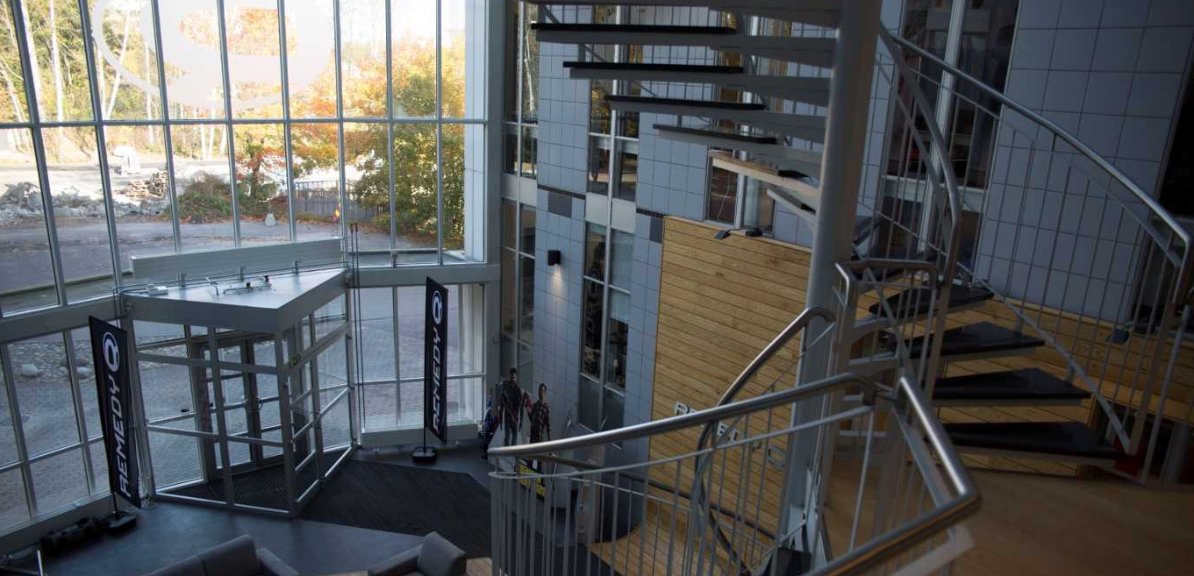
REMEDY ENTERTAINMENT PLC.
Founded in 1995 | Espoo | Finland | 165+ employees
BEST KNOWN FOR:
Max Payne | Alan Wake | Quantum Break
CURRENTLY WORKING ON:
P7 (own IP) with 505 Games
CrossFire 2 (Story Mode) with Smilegate
Northlight engine and tools
Notes:
(DO NOT spend too long on this slide)
Quickly, about Remedy, if you don’t know us.
You know Remedy from games like Max Payne, Alan Wake and Quantum Break which we released back in April 2016.
We are based in Espoo, Finland where we have our own custom designed building. We got a dedicated sauna at the building. This is Finland after all.
We are currently working on two games: P7, which is a multiplatform game we are developing with 505 Games. This game will be out in 2019 for console and PC platforms.
Then we are working on our first, first person shooter which is Crossfire 2 for Smilegate. Specifically we are creating the campaign mode for it.
We also have a dedicated in-house engine and tools team.

Slide 6
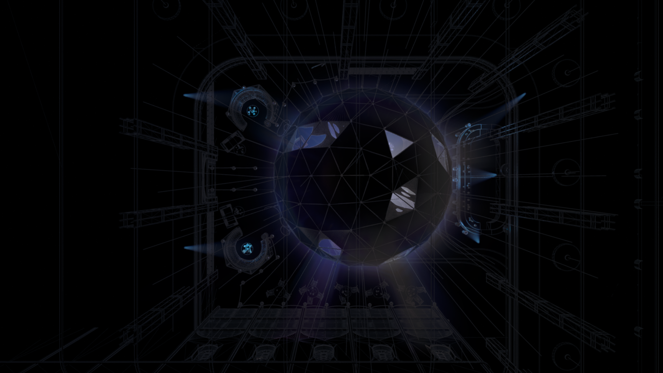

Agenda
Quick introduction to DirectX Raytracing
Area shadows
Ambient occlusion
Reflections
Indirect Diffuse
Notes:
My agenda on this presentation will be, to give you a little glimpse on what you can do with raytracing integrated into a game engine. I’ll start, by giving a very quick introduction, to high level concepts of DirectX Raytracing. After that, I’ll walk you through couple examples, on what we have tried out and how the results were. We’ve started of, by making reference implementations of a few techniques we are already using. The hope is, to find some new ways to make things, also on platforms that aren’t powerful enough for raytracing.

Slide 7
Notes:
In order to explore, we’ve created a new moody scene, that’s not connected to our games. I’ll start off with a demo, and will discuss the new technical aspects after it. I recommend to keep an eye on how the pieces fit together, and on how the different aspects of the lighting work.

Slide 8
Notes:
Demo video

Slide 9
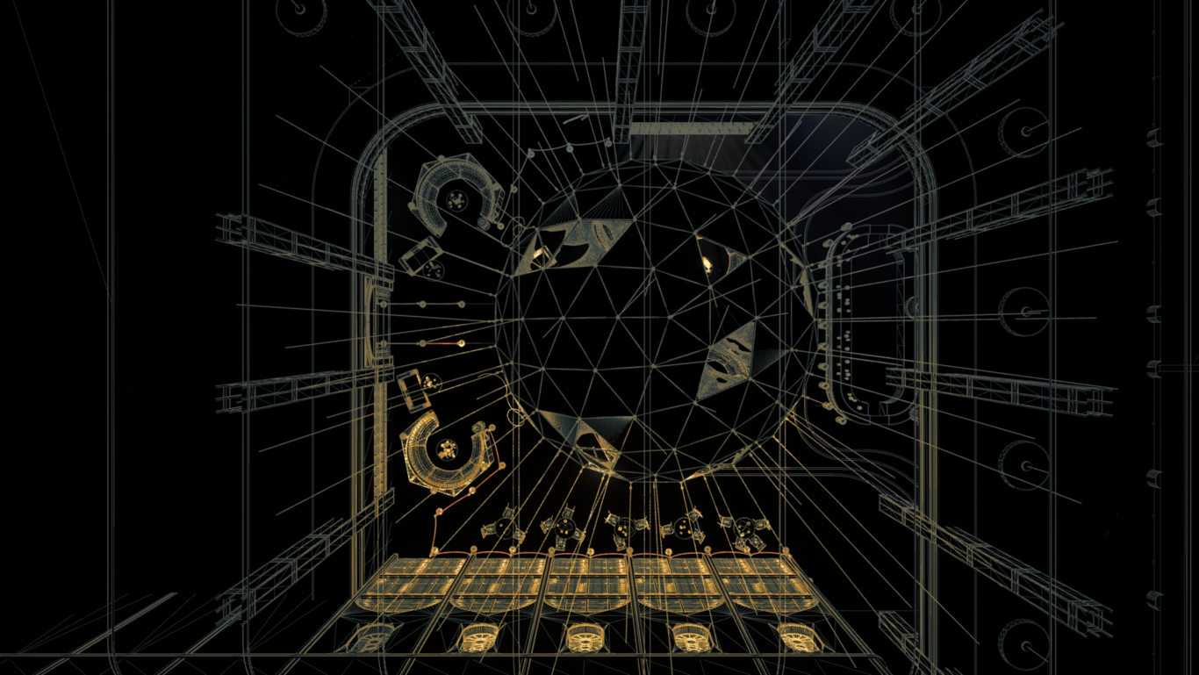
Visibility based algorithms
Notes:
Let’s start with very high level introduction on DirectX raytracing. I will not go through the API in this presentation, but I’ll try to give you some background on what you need to do before you can start shooting rays.

Slide 10
Visibility based algorithms
Top Level
Bottom Level
Notes:
Raytracing API provides Bottom and Top level acceleration structures. The idea is, that bottom level structure is constructed to hold geometry, while the top level contains bottom level structures. Simple way to think about this is that each mesh should be a single bottom level structure. And top level tree is your scene that contains bunch of bottom level structure instances with some transformation.

Slide 11
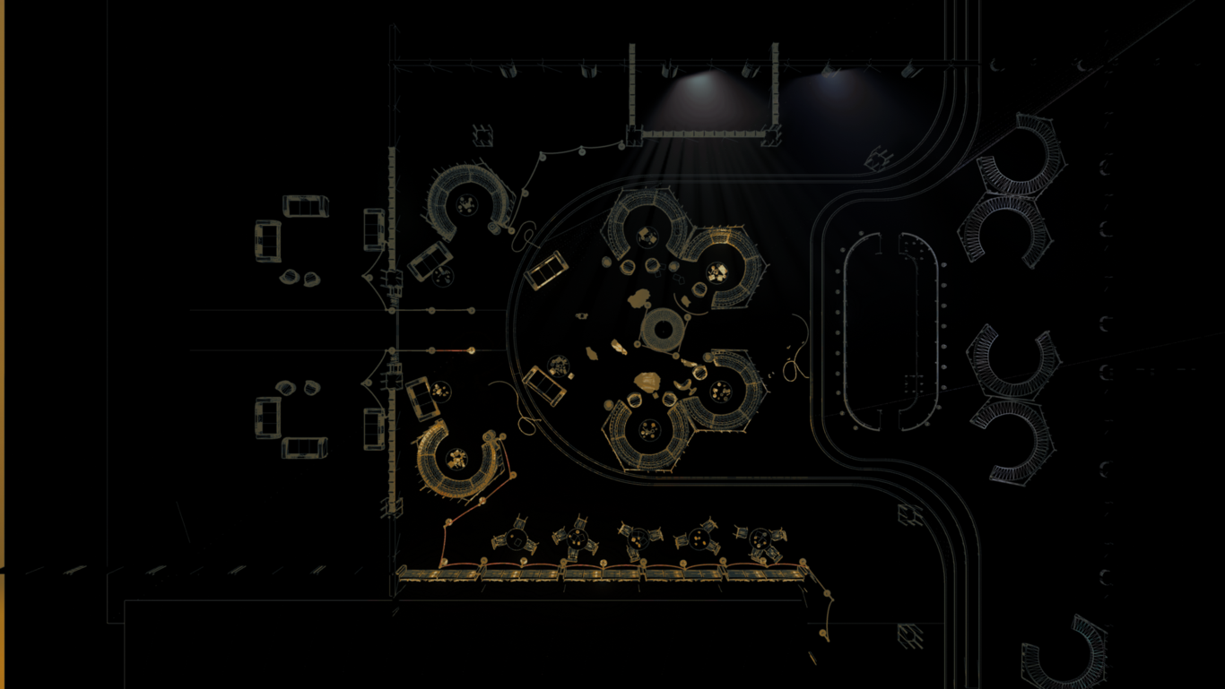
Bottom Level
Notes:
The first thing, you are going need, is the bottom level structure for the static parts of your scene. In this picture, each red square represent bounds of a single bottom level tree. Building bottom level tree is very simple. In API, you’ll have a function, that takes normal DirectX GPU geometry and index buffers, and returns bottom level tree build around the geometry.

Slide 12
Bottom Level
Notes:
So in here, I have highlighted four instances of a small chair seen in the demo. These four chairs share the same geometry, but have separate transformations.

Slide 13
Bottom Level
Notes:
The mid size trees are small sofas.

Slide 14
Bottom Level
Notes:
And the biggest ones are large round sofas.

Slide 15
Top Level
Notes:
In order to build a scene for raytracing, you’ll need to insert these bottom level structures into a top level structure. This is again very simple thing to do. The API provides you a function that takes in a number of bottom level tree instances with transformations. Building a top level tree is fast, so you move static meshes every frame and then just build top level from scratch each frame.

Slide 16
Dynamic Geometry
Notes:
Supporting deformed geometry is a bit more tricky, as the bottom level builder eats only static buffers. For us, the easiest way to support deformation, was to create a simple compute shader that takes in geometry and skinning matrices, and writes out deformed geometry. This is still very fast, as you can keep everything on GPU, and just feed the output from the compute shader to the bottom level builder.

Slide 17
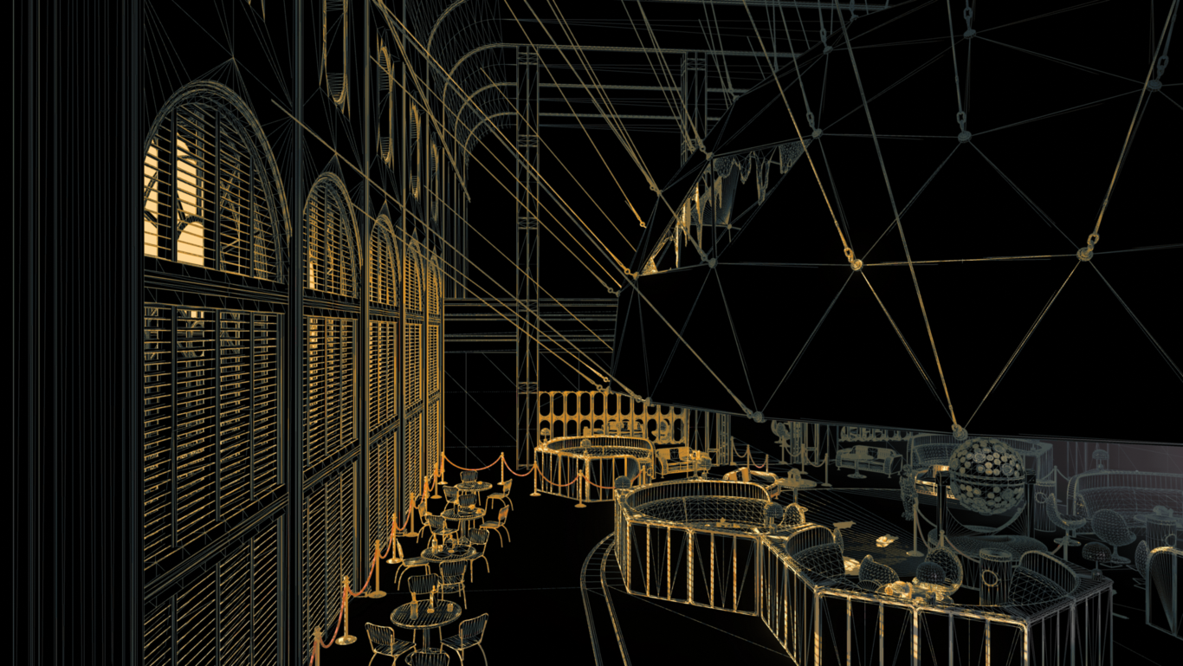
Notes:
And that’s it, now you can start shooting rays. I’ll start of, by showing couple examples you can try out with data only.

Slide 18
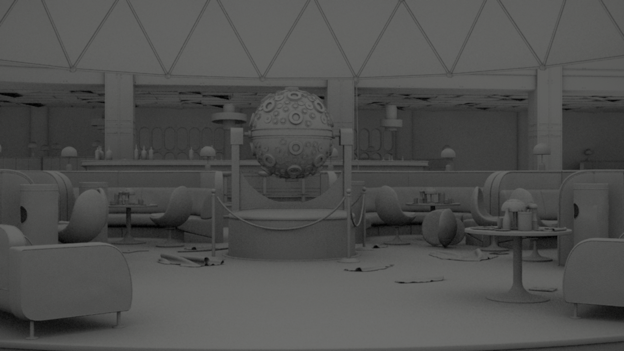
Ambient Occlusion
Notes:
Ambient occlusion is purely visibility based algorithm that can be easily tested out with raytracing. Image you see on here, is taken by shooting 4 samples per pixel using cosine distribution. Maximum length of the rays is set to four meters, and hits to geometry are considered black and others white. This is added as a direct replacement to what our screen space ambient occlusion outputs, so it is easy to compare results of different algorithms.

Slide 19
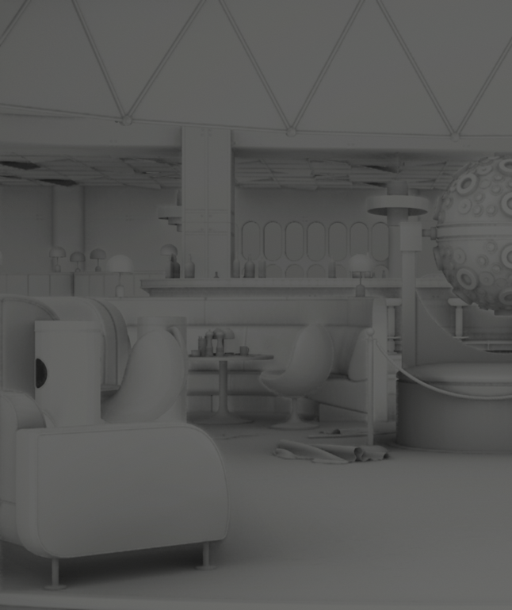
Ambient Occlusion
Screen Space
Raytraced
Notes:
This is split screen, with screen space ambient occlusion on the left side, and raytraced ambient occlusion on the right. While the screen space technique does pretty good job on grounding things, it’s clearly lacking information. Screen space algorithms, can’t know what’s outside the screen or behind the surfaces that are directly visible to camera.

Slide 20
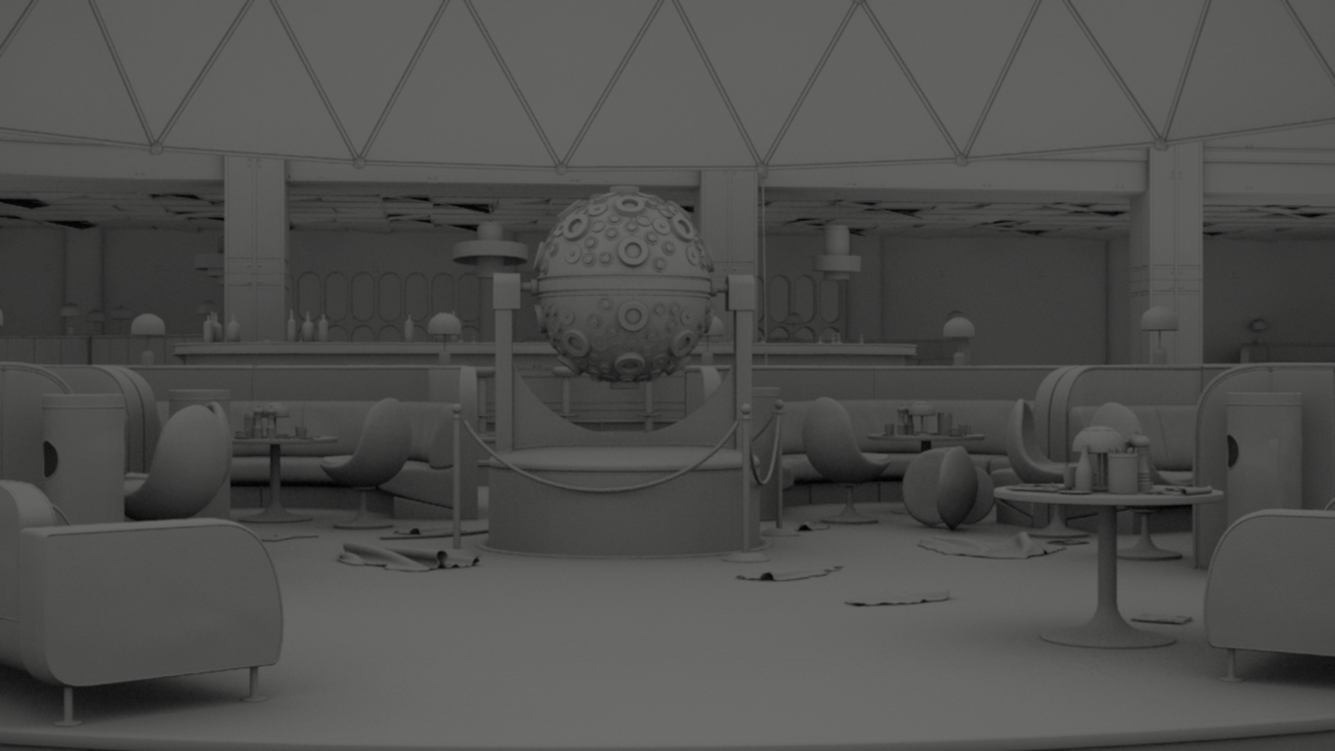
Ambient Occlusion
Single ray per pixel on 1080p is roughly 5ms
Notes:
Shooting rays is of course more expensive that looking up screen space depth. In our quick prototype, shooting a single ray with maximum distance of four meters, costs roughly 5 milliseconds. The cost scales pretty much linearly, so shooting 16 rays for full HD picture, takes roughly 80 milliseconds. The picture you see here, is shot with 16 rays.

Slide 21
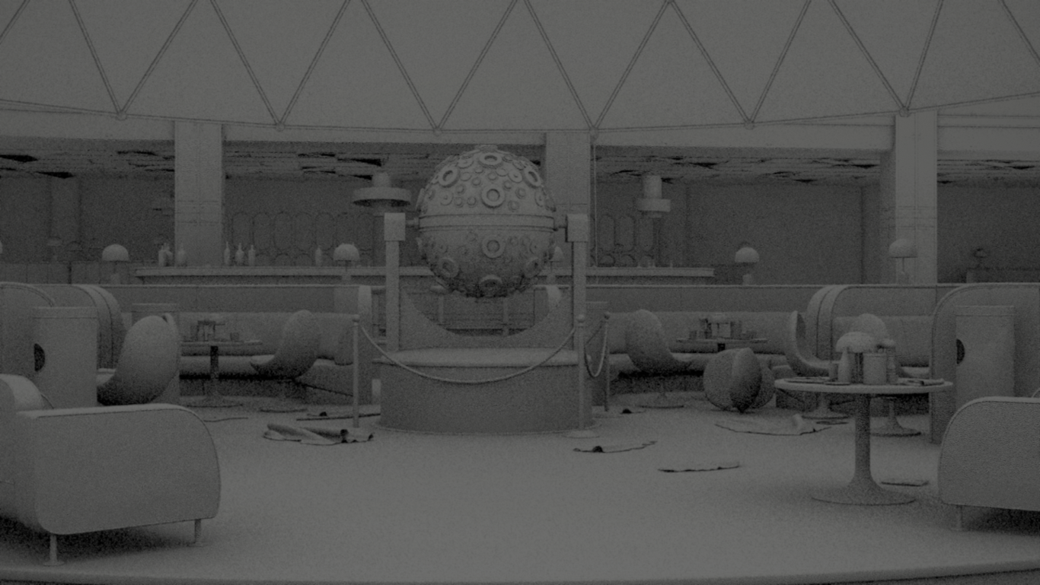
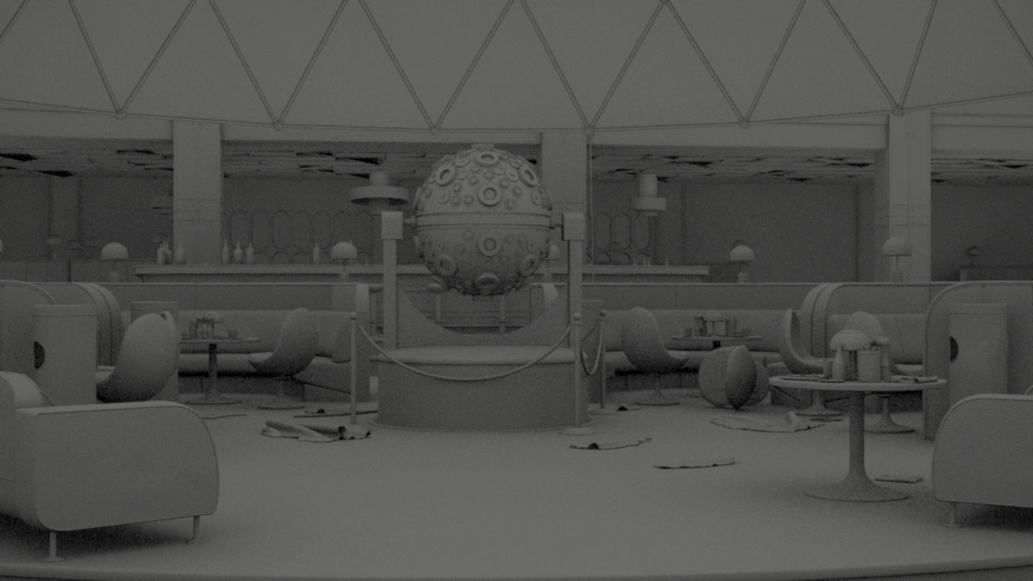
Ambient Occlusion
1 rpp
2 rpp
4 rpp
16 rpp
Notes:
Finally, here you can see a picture with comparison of different ray counts. You should note, that these are all taken with just our basic temporal anti-aliasing. I’m sure it would be possible do better job with filtering noise. Ok, next move to next topic.

Slide 22
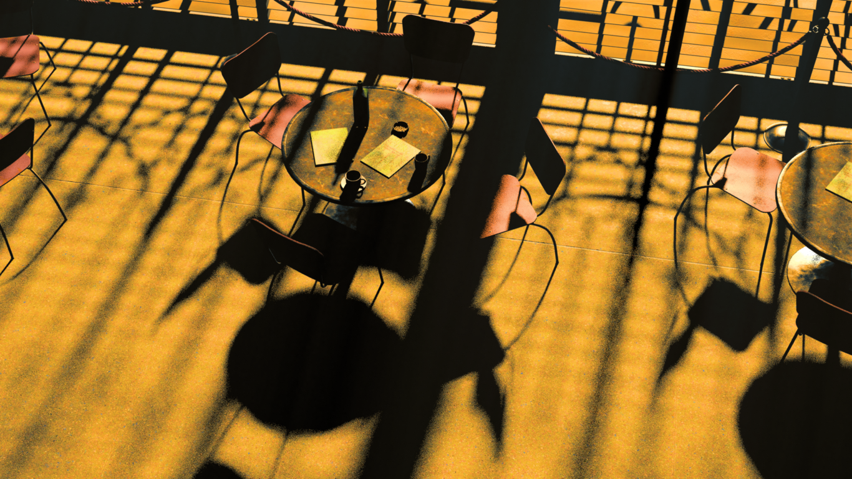
Shadows
Notes:
We implemented a path to replace sunlight cascaded shadow maps by shooting rays. If you happen to fill the shadows of the directional light into fullscreen buffer before actual lighting, it’s very easy to just replace cascade map lookup shader with raytracing kernel that writes into the same texture.

Slide 23
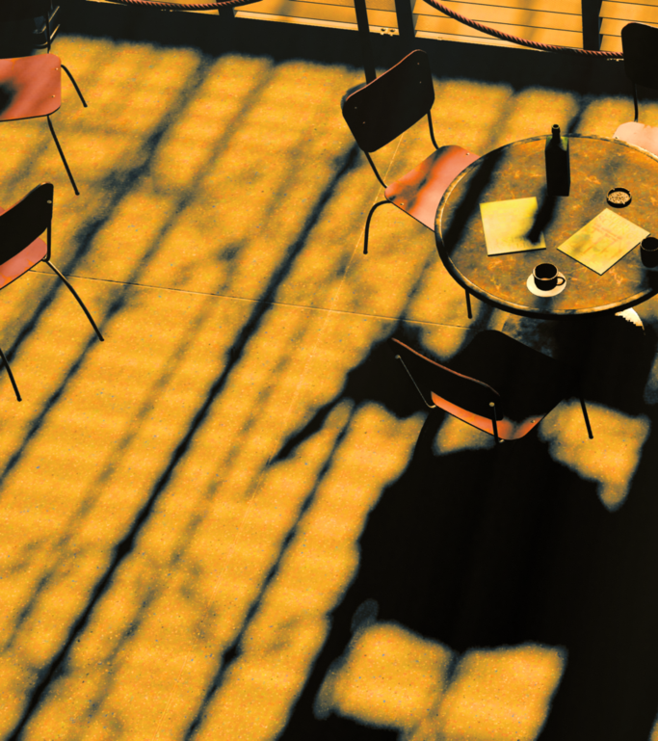
Shadows
Shadow Map
Raytracing
Notes:
Here you can see a comparison using shadow maps on the left side, and raytracing on the right side. In order to be fair, I didn’t try to tune up the resolution on shadow maps, so this is just something we get out of engine with default settings. Anyway, the amount of detail you can gain with accurate shadows is pretty remarkable.

Slide 24
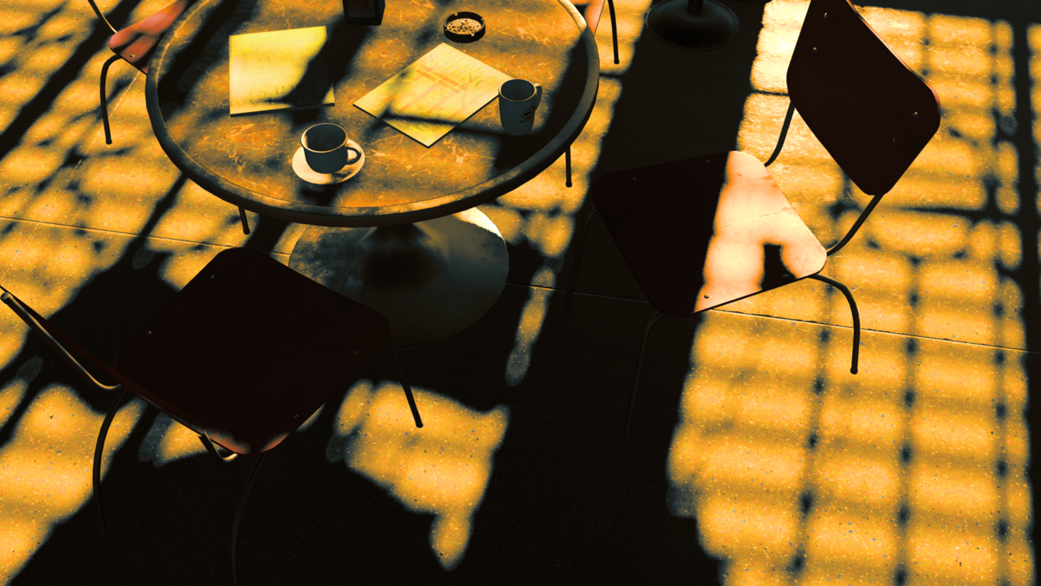
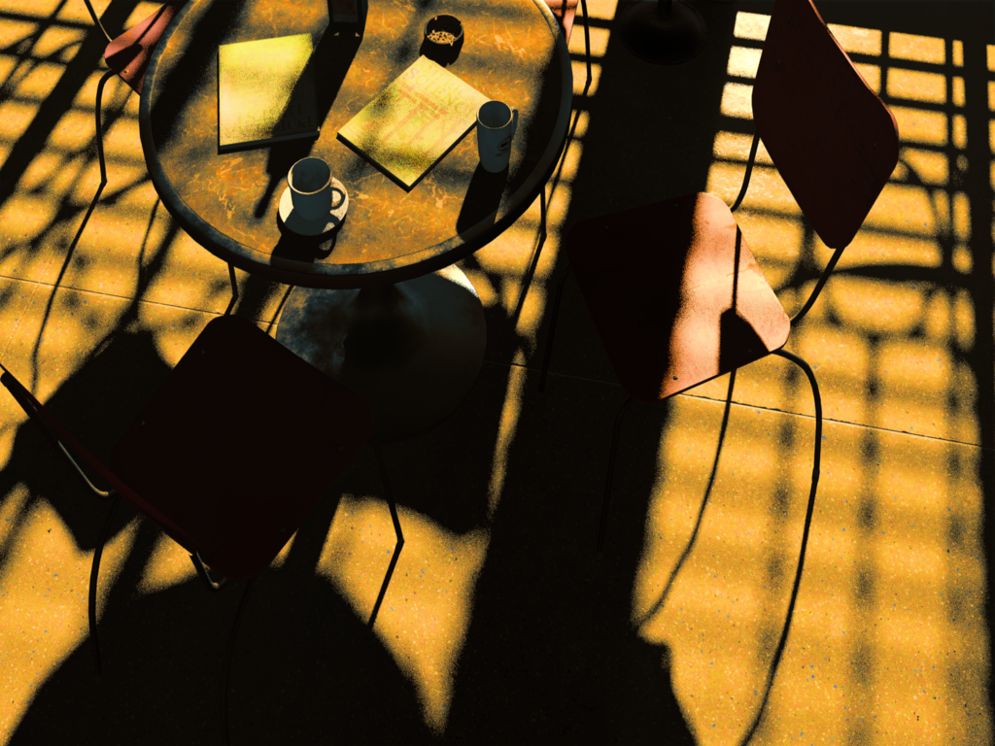
Shadows
Shadow Map
Raytracing
Notes:
Here you can see closeup comparison between shadow maps and shadows with raytracing. Image with raytracing is using eight samples per pixel and does not have spatial filtering. Shadow map image on left side, is using 16 PCF samples and spatial filter applied on top of the screen space buffer.

Slide 25
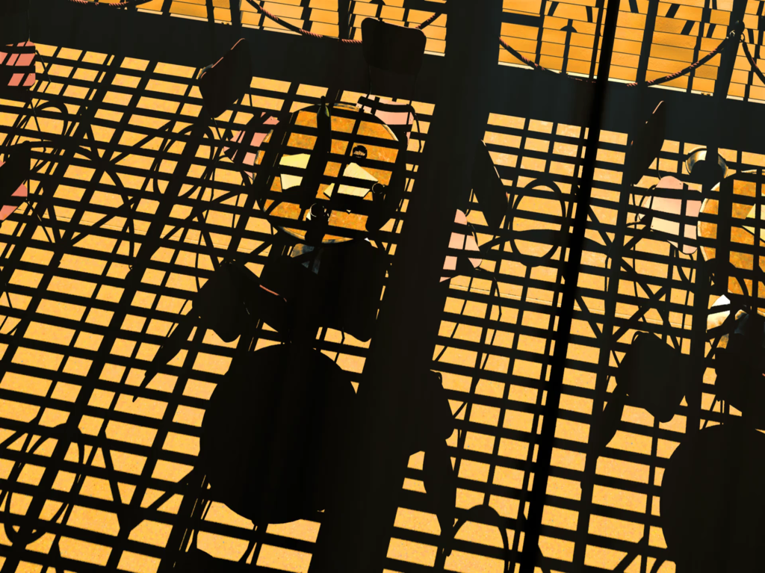
Shadows
Notes:
In addition to accuracy, it’s easy to do real area shadows with raytracing. Clip here is using eight samples. Sampling pattern is basic blue noise, that’s changing between frames. For each sample on the pixel, we offset the same blue noise with sobol sequence and wrap the values on a disk.

Slide 26
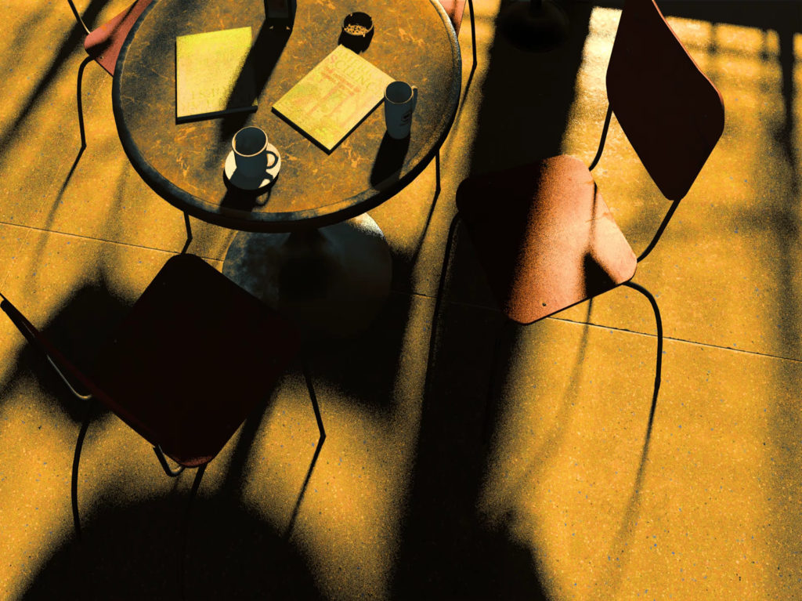
Shadows
Notes:
Here, you can see a closeup of the same effect. As you can expect, with raytracing the contact points are accurate, and you get nice mix of sharp and soft shadows. While this is nothing new or radical on algorithm level, its insanely cool to be able to go and look your existing game scenes to see how much detail is lost without accurate shadows.

Slide 27
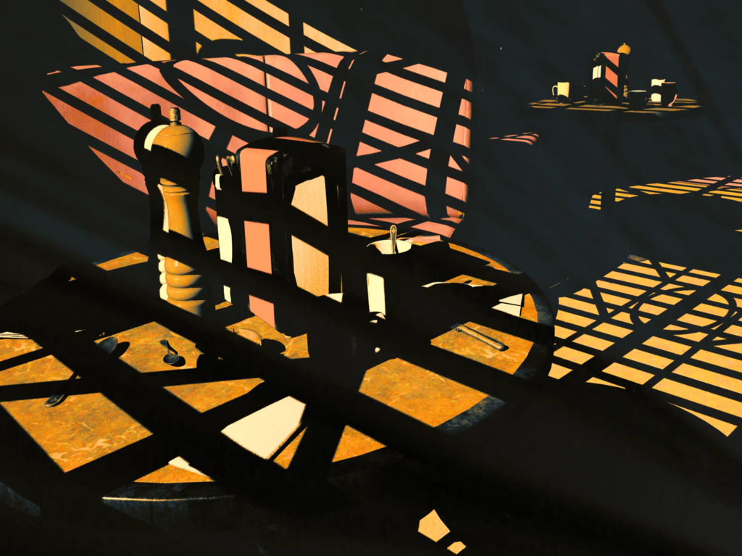
Shadows
Notes:
And here is one more example. Looking at the amount of detail added to simple scene like this, makes you wonder if there is any sense to keep increasing the output resolution, before we can sample lower resolutions with good quality.

Slide 28
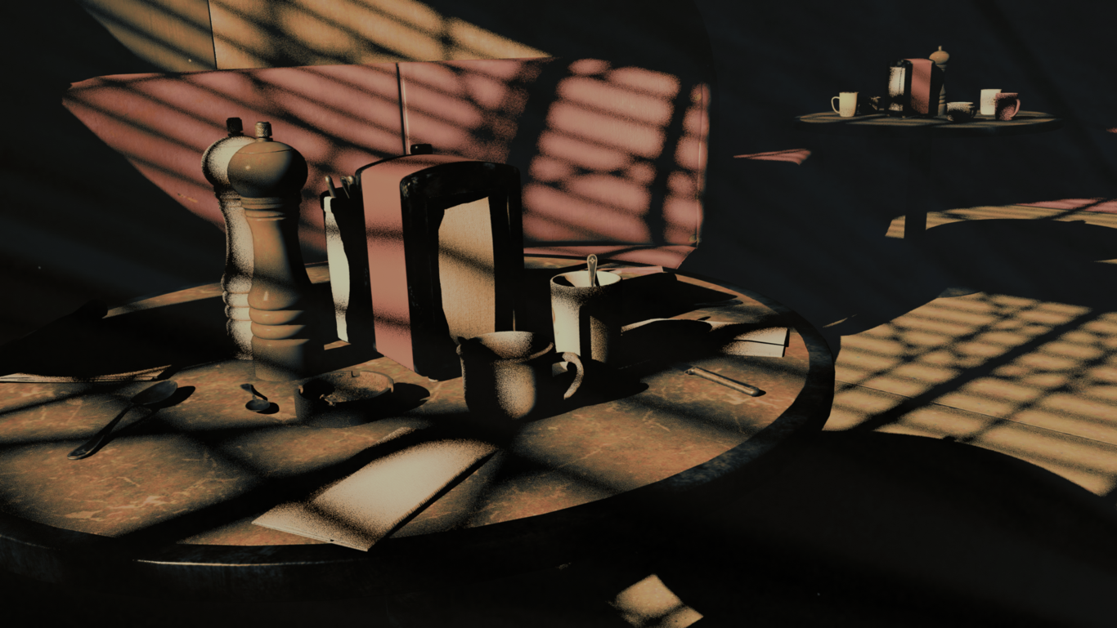
Shadows
Single ray per pixel on 1080p is under 4ms
Notes:
In our demo, the performance on shooting shadow rays is a bit better than with ambient occlusion. Even though the rays are longer, resolving shadow visibility is more coherent load than ao. Getting something like this up and running with existing DX12 engine should take you something like few days. I can say that it’s definitely worth the effort, even if you are just going to use it as a reference.

Slide 29
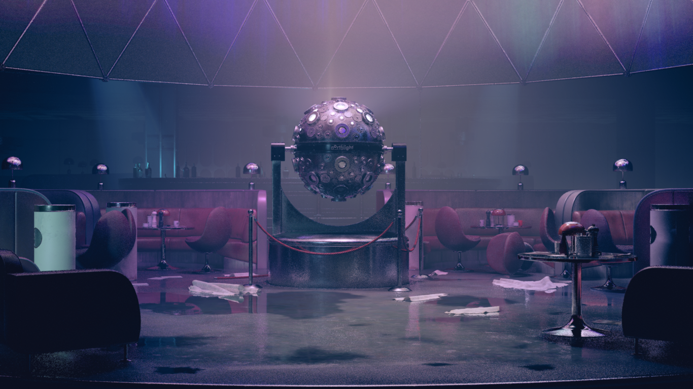
More than visibility
Notes:
I’ve been talking about algorithms, that can be implemented by knowing only visibility between two points in the scene. Going beyond visibility requires access to additional data. In this section, I’ll quickly introduce, how we exposed geometry, materials and lighting to be used in raytracing kernels.

Slide 30
More than visibility
Geometry
Notes:
On a geometry hit, the API provides you the intersection point in scene and triangle base. Other geometry properties than position, you will need to read in manually and interpolate based on barycentric coordinate. This means, that you will need to be able to access all your geometry from shader. New DirectX comes with a new binding API, where you can set different resource bindings for each instance of a bottom level piece in the scene.

Slide 31
More than visibility
Geometry
1
2
2
3
4
5
Chair 1
6
2
7
8
9
10
Chair 2
Notes:
So let’s say, I have two instances of a chair. Each chair has five pieces for different materials, like in the diagram on this slide. I can now define separate resource bindings for all the pieces, so in total I have ten resource binding records. Each of the record can then have a custom binding for vertex and index buffer for example.

Slide 32
More than visibility
Geometry
1
2
2
3
4
5
Table 1
6
2
7
8
9
10
Table 2
Notes:
Other option we tried first, was to reserve separate space from a descriptor heap for all the buffers in the scene, and then index those manually from hit shader code. In the end, doing bindings using multiple root signatures turned out to be quite a lot faster, so we ended up going with that.

Slide 33
More than visibility
Material parameters in buffer
Textures in descriptor heap
1
2
3
4
5
6
1
2
3
4
5
6
Draw calls
Notes:
It would be possible to bind material data using the same API, but just before starting with DXR, we had completed a new material binding system that works also with basic DX12. By packing all the material parameters into a single buffer, and reserving dedicated space on front of the descriptor heap, we could already do draw calls without additional bindings. This also means, that we can access everything related to materials in a single shader call. Each index on this slide, refers to single material.

Slide 34
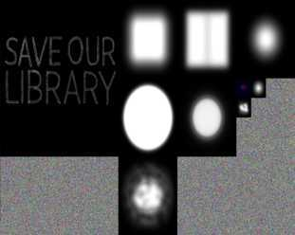
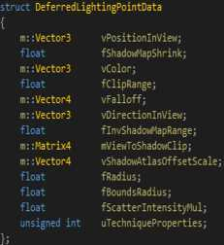

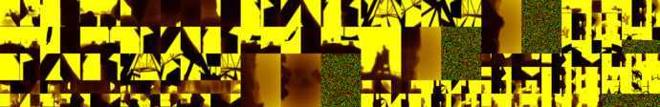
More than visibility
Lighting
Notes:
Lighting happened to be easy for us also. Since Quantum Break, we have already had all the lighting data accessible to a single shader call. This means, that we pack all the shadow and projection maps in few atlases. We also keep light parameters packed in buffers. That’s it. Now we have geometry, materials and lights exposed in a way, that we can access everything in a single raytrace kernel. Let’s get into trying out reflections next.

Slide 35
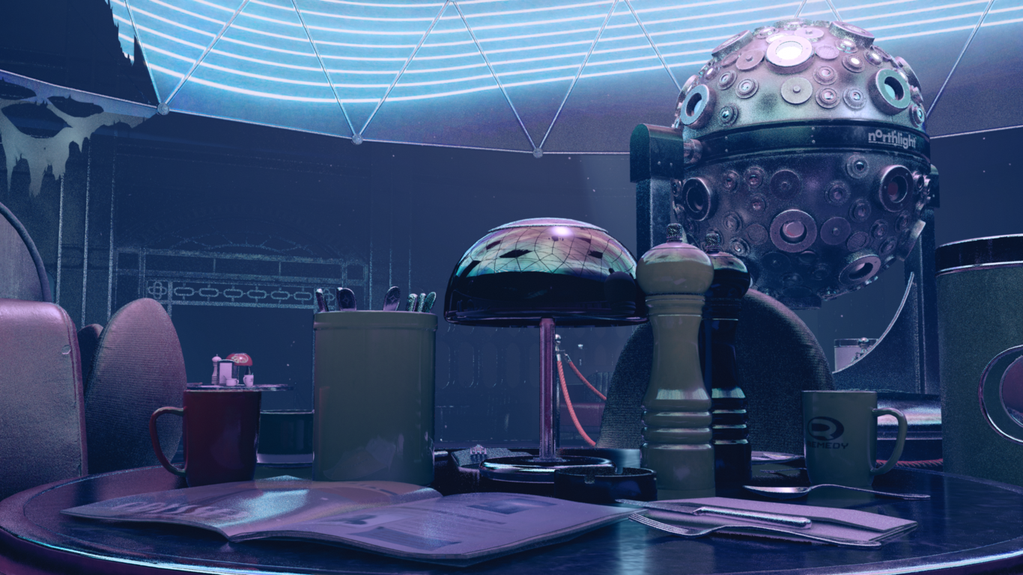
Reflections
Notes:
Ok, this is getting more interesting. Following section is dedicated to implementing reflections with raytracing. I’ll start up by quick comparison to our screen space technique, and continue to visualising how the previously introduced data bindings are used. As with the previous techniques shown, we implemented raytraced reflections as a direct replacement to screen space technique. This way, it is easy to compare the results again.

Slide 36
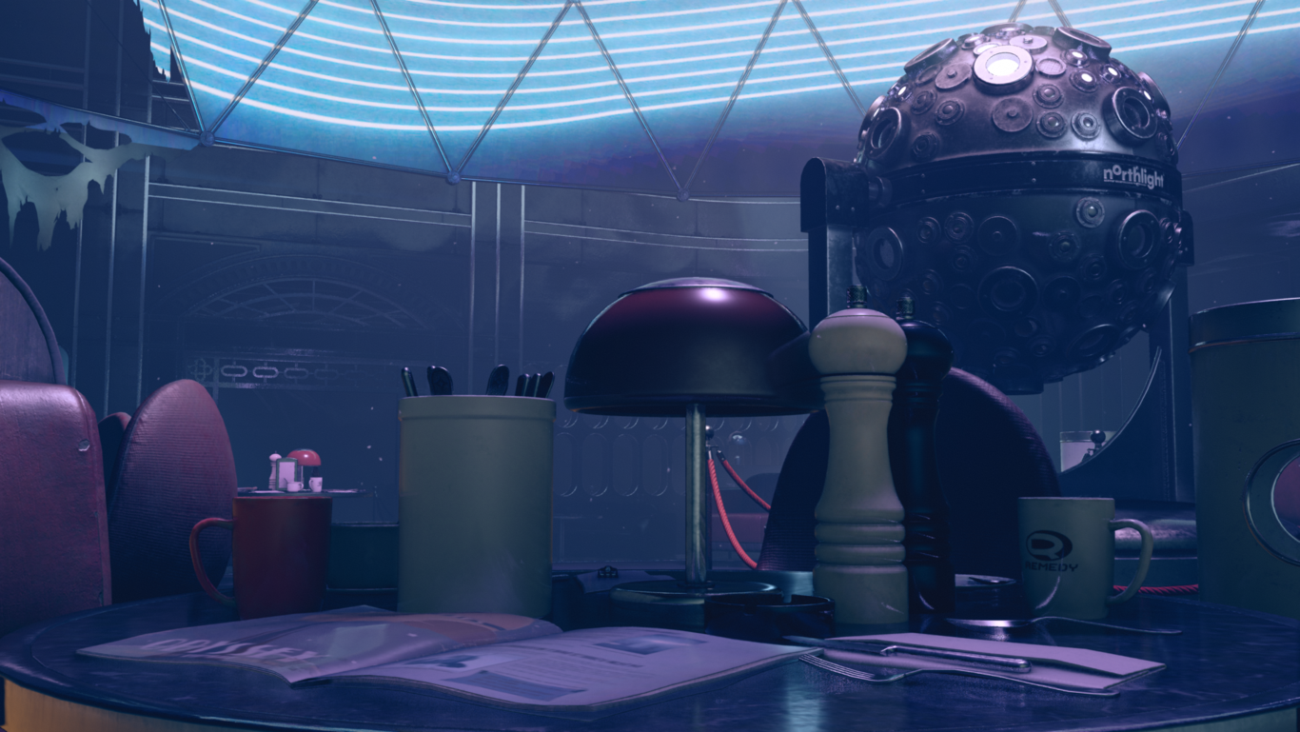
Reflections
Screen Space
Raytraced
Notes:
So here you can see split screen comparison, with screen space reflections on the left side, and raytracing on the right side.

Slide 37
Reflections
Screen Space
Notes:
This is screen space only. Reflection ray generation works the exact same way in both the screen space and raytrace technique.

Slide 38
Reflections
Screen Space
Notes:
For the each sample on the screen, you read properties of the surface from the geometry buffer. Then based on smoothness, you pick a random direction from ggx distribution and transform it according to geometry normal.

Slide 39
Reflections
Screen Space
Notes:
On screen space, we treat reflection ray as a 2d line, from a point on screen to a point on edge of the screen. In order to figure out if the ray hit geometry, we take number of depth samples along the line. It’s possible to miss features along the way due to holes in sampling, and due to having access to only directly visible surfaces.

Slide 40
Reflections
Screen Space
Notes:
Also, the hit position can be outside of the screen. I don’t have any backup solution in use on this picture. The most obvious fallback would be to sample some cube map when the ray hit is out of the screen. Next, let’s get back to raytracing.

Slide 41
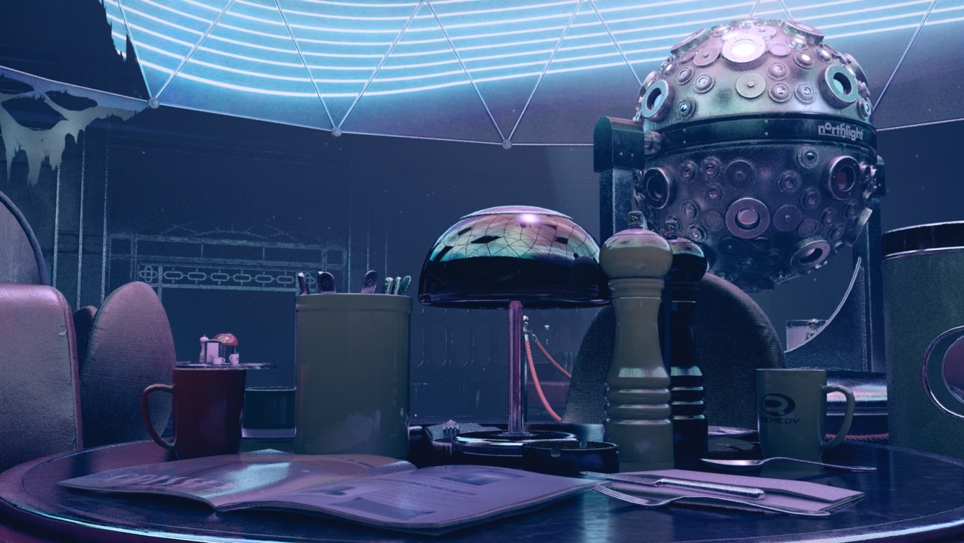
Reflections
Raytraced
Notes:
Raytracing doesn’t miss any geometry that is out of the screen, behind visible surfaces, or due to lack of samples. On a geometry hit, we need to figure out radiance transmitted towards reflection ray origin. For this, we need to know the material and the lighting at the hit location.

Slide 42
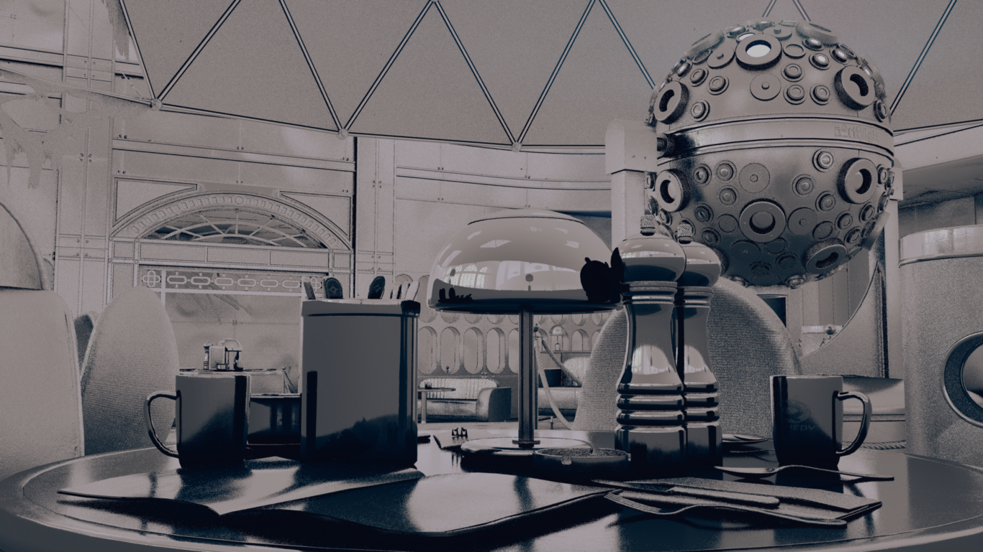
Reflections
Distance intrinsic
Notes:
DXR provides the hit distance, position and barycentric position within a triangle as an shader intrinsic. With this information, we can interpolate UVs from the geometry buffers exposed earlier.

Slide 43
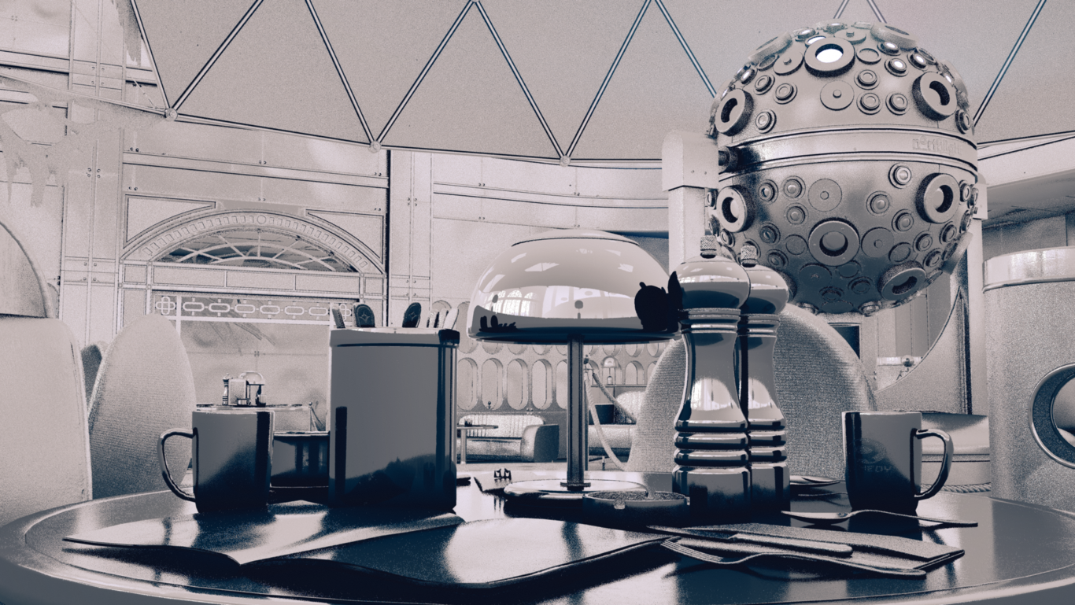
Reflections
Distance
Notes:
In order to sample surface properties on the surface that reflection ray hit, you need information we discussed in earlier section. From geometry data, you need to first figure our UV coordinate of the hit surface.

Slide 44
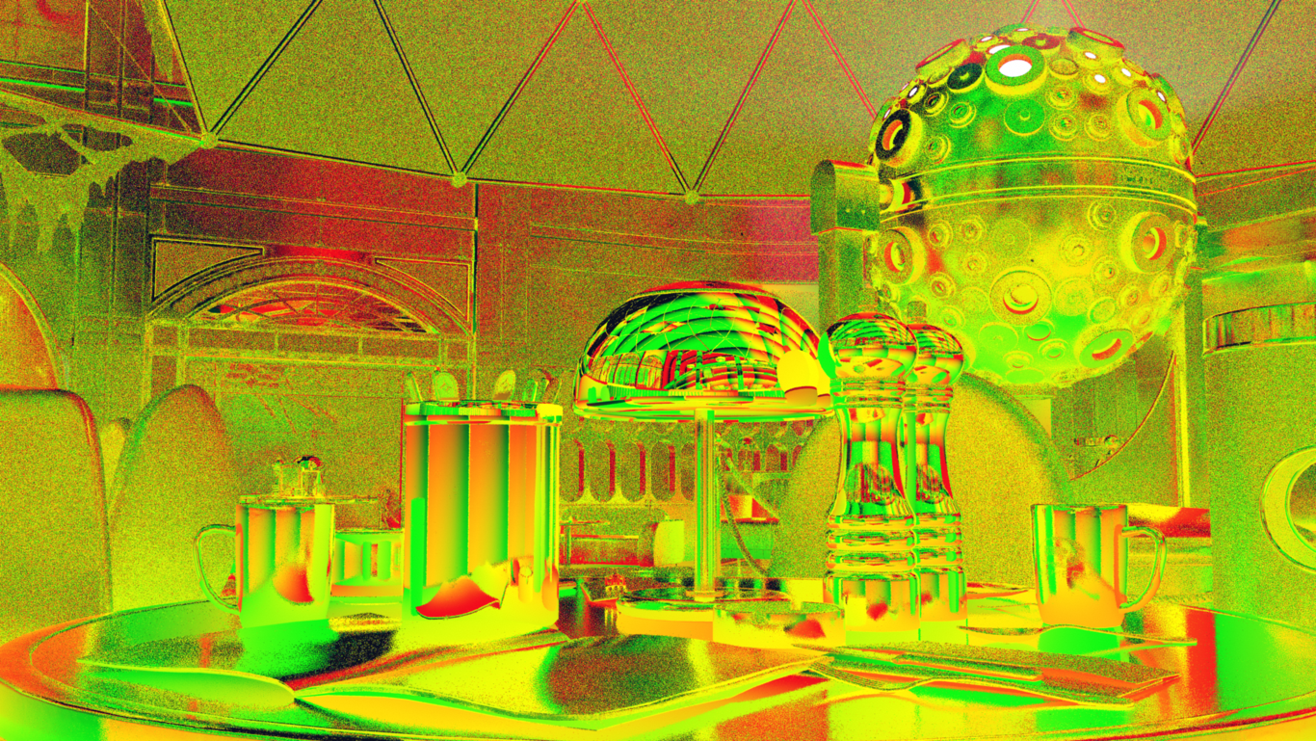
Reflections
Texture Coordinates
Notes:
So the UVs at the reflection hit location will end up looking a mess like this. With the UV and other data, we can sample the rest of the material properties.

Slide 45
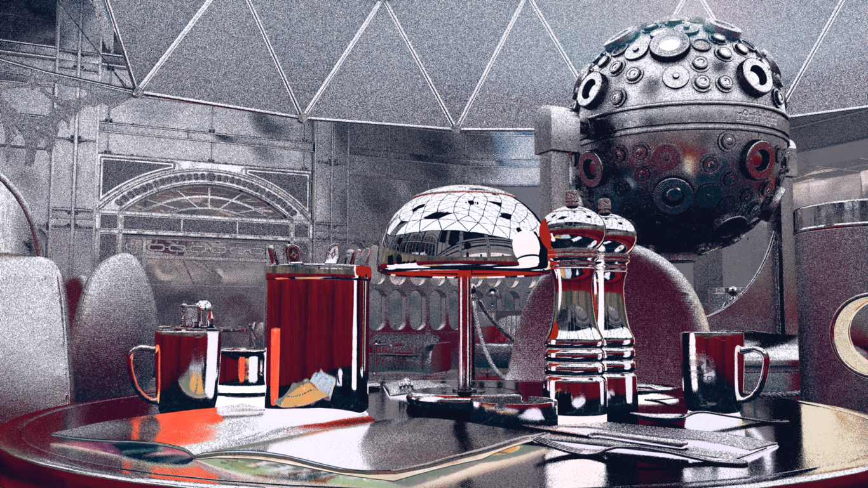
Reflections
Diffuse Albedo
Notes:
Here, you can see the diffuse albedo of the reflected surface. Next, it’s time to evaluate the lighting and combine the results.

Slide 46
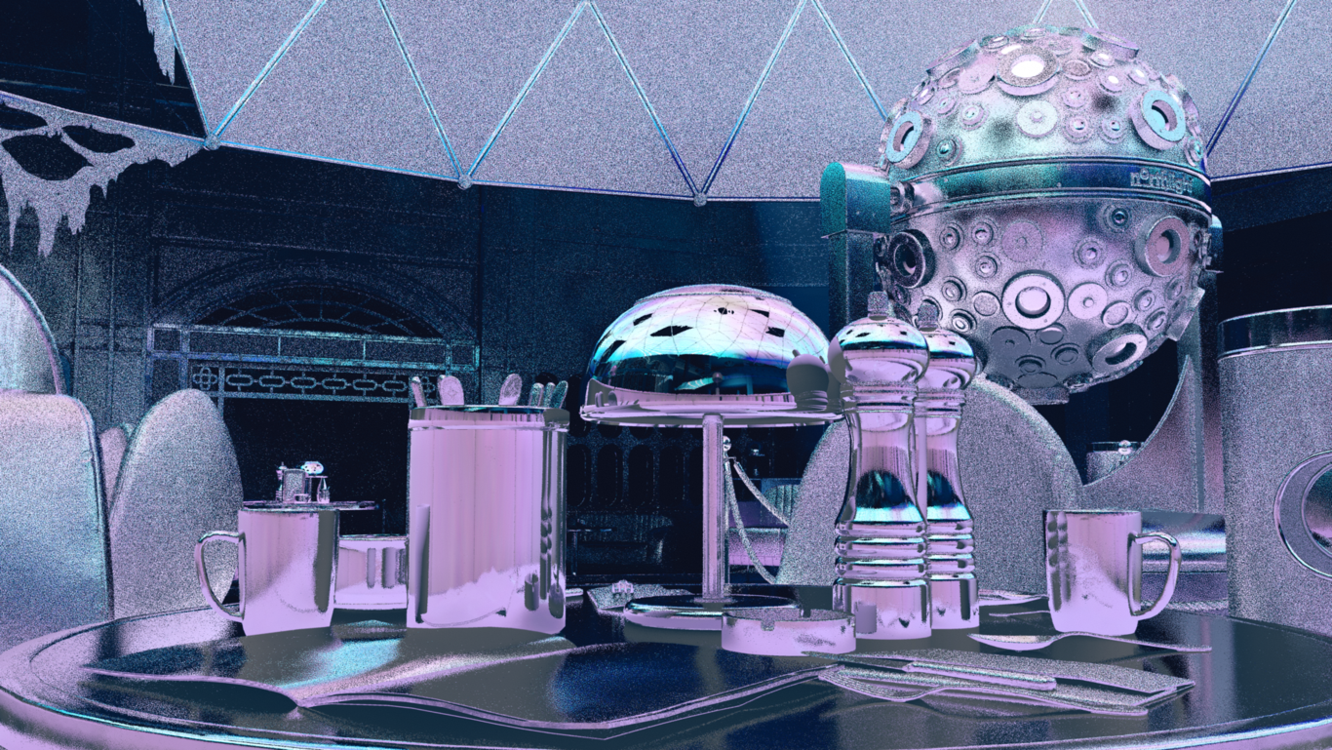
Reflections
Lighting
Notes:
This is lighting at the reflected surface. We can now combine this and material with fresnel term.

Slide 47
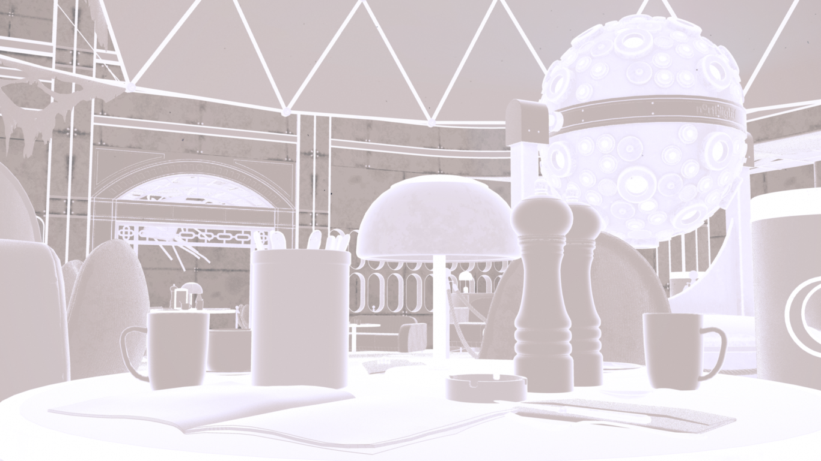
Reflections
Fresnel
Notes:
This is the basic schlick fresnel term we are using in the demo

Slide 48
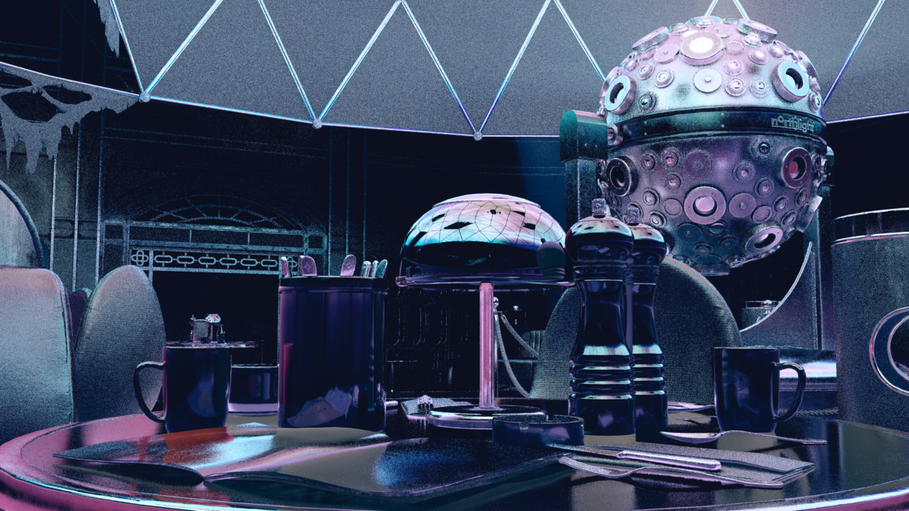
Reflections
Fresnel * Lighting * Material
Notes:
And the result will look like this. This is reflection only visualisation. In order to get the final image, we combine this with diffuse and specular component of direct lighting.

Slide 49
Reflections
Notes:
This is the final image. As you can expect with the techniques like this, the end result will have some amount of noise. We didn’t have a lot of time to experiment with noise filtering, but I have couple image loops to visualise the problems. The following loops are taken from a bit harder lighting case, and are using our basic temporal anti-aliasing.

Slide 50
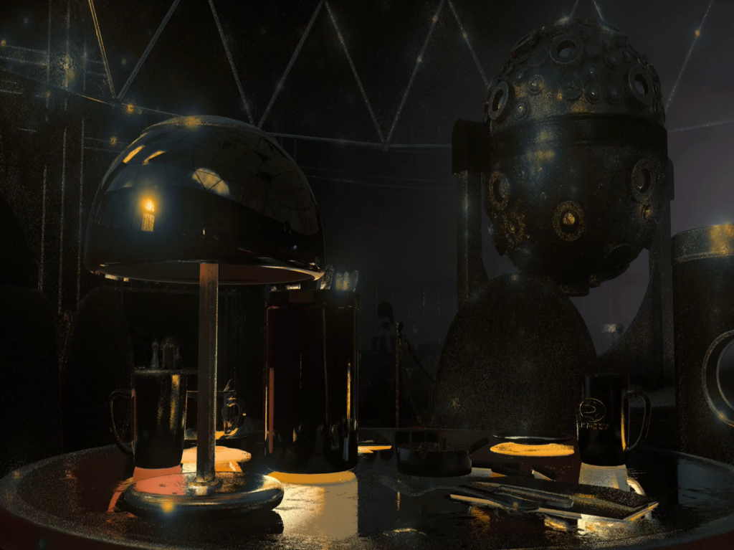
Reflections
1 ray per pixel
Notes:
This is the raw image you get, when shooting a single reflection ray per pixel, without any filtering. The lighting here is from sun light. This is pretty hard case, as the lighting has high contrast and a lot of detail. As we all know, the variance in the lighting decreases when shooting more rays per pixel. While shooting more rays for all the pixels is expensive, with raytracing it’s easy to pick few locations to shoot more.

Slide 51
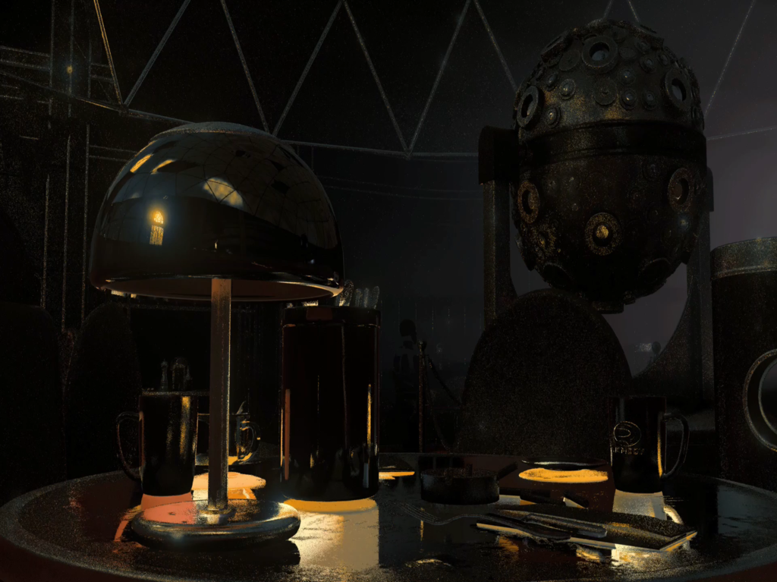
Reflections
+ 3 rays on bright pixels
Notes:
It’s almost free to shoot couple more rays for the pixels that are over two times more bright than the white point in the image. In this loop, you can see that we can remove most of the fireflies with just this. Would be interesting to see where using something more advanced like gradient domain sampling would get us.

Slide 52
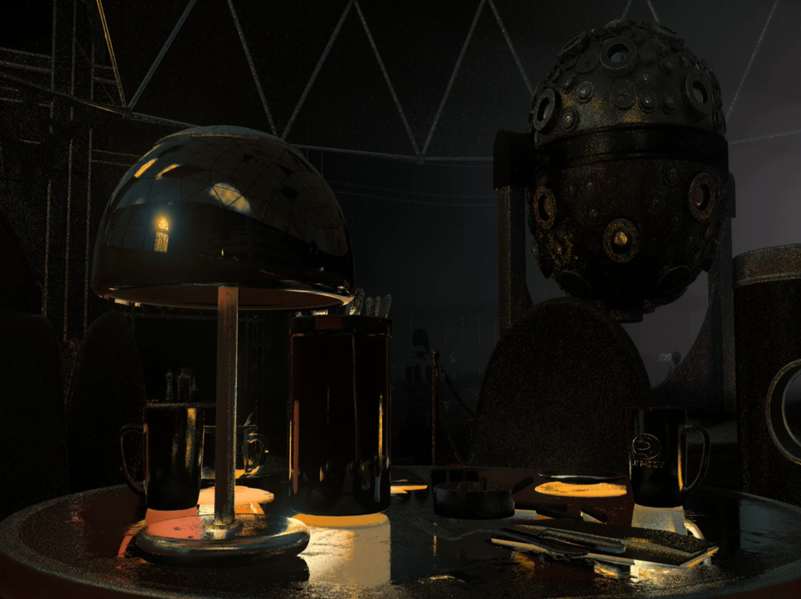
Reflections
and combine with small damping
Notes:
In the demo, we are also clamping the reflections that are over ten times brighter than the white point on the image. This is of course a hack, and I don’t recommend to do this, unless you need to ship it.

Slide 53
Reflections
Optimise by using shadow maps
Notes:
While it would be perfectly possible to use raytracing to resolve shadows at reflected surfaces, we use shadow maps for the most of the lights in the demo. The only exception is the sun light. Since we use cascaded shadow maps with the sun, there is valid depth for only the pixels on the screen. Having to shoot a single shadow ray, for the sun, on every reflection ray, almost doubles the cost of the reflections. Thats all about reflections. Lets look at the diffuse lighting next..

Slide 54
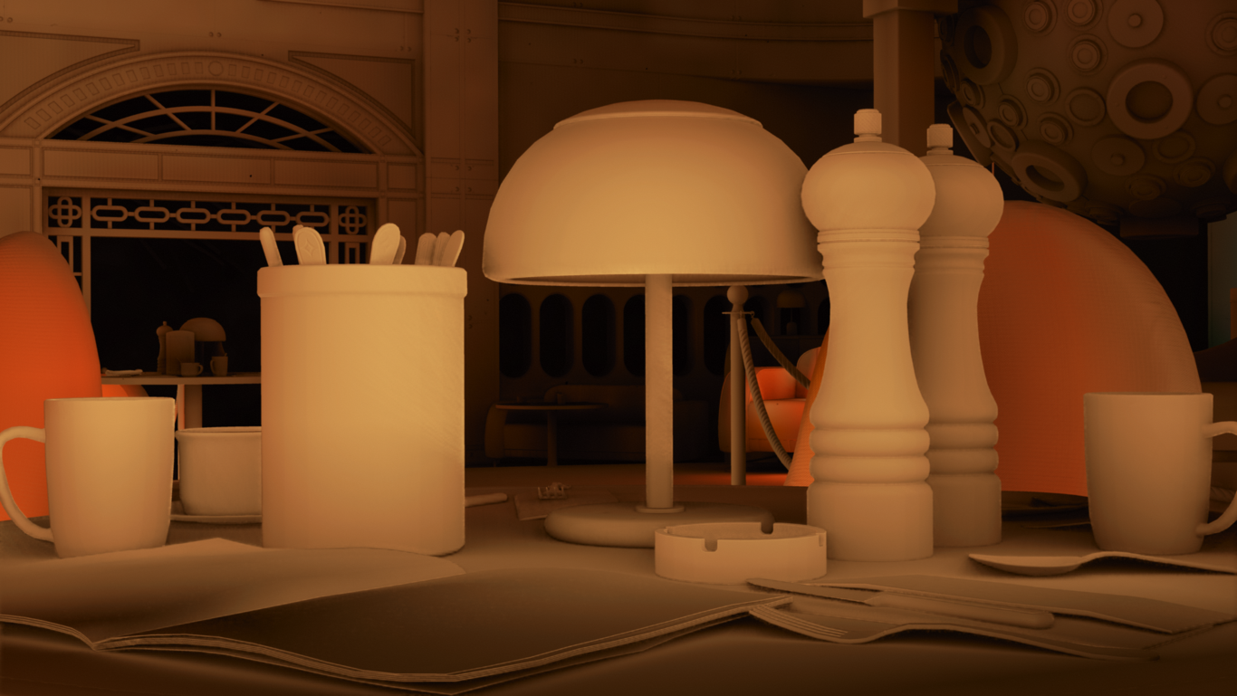
Indirect Diffuse
Notes:
In this picture, I have diffuse global illumination, interpolated from the volume texture. The approach you see here was implemented for Quantum Break, and is in use by default in our engine. Voxel resolution of the GI data here is 25 cm. We combine the results with screen space ambient occlusion. As I showed you earlier, we have a path to replace screen space AO, with raytraced one. Let’s have a look on how that looks.

Slide 55
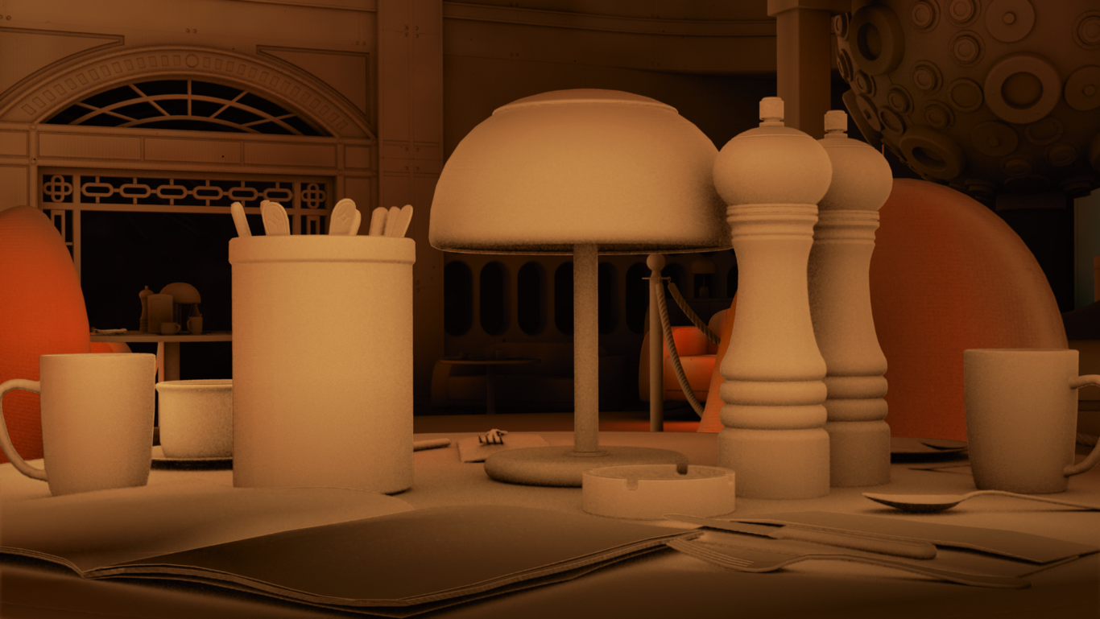
Indirect Diffuse
Notes:
This is the same data, combined with raytraced ambient occlusion. Results are better, but this still looks like ambient occlusion applied on top of volume data that doesn’t have enough resolution for the case seen here.

Slide 56
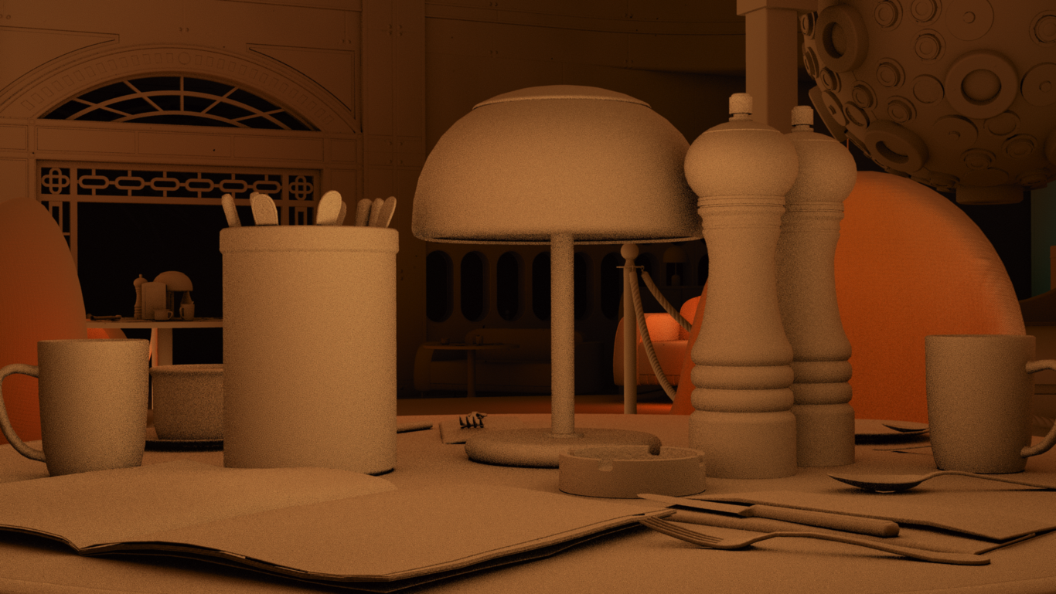
Indirect Diffuse
Similar to AO, lots of non-coherent rays
Notes:
Instead of just shooting a lot of rays around to resolve indirect diffuse lighting, I’ll be talking a bit about improving sampling of volumetric global illumination, and resolving near field global illumination. Lets quickly break this down with few diagrams.

Slide 57
Indirect Diffuse
GI stored in sparse grid volume
Notes:
Our pre-computed global illumination is stored in sparse volume texture. The grid on the screen, represents the data. Each crossing, contains indirect lighting data, that has been calculated with pathtracer.

Slide 58
Indirect Diffuse
Irradiance calculated based on static geometry and static set of lights
Notes:
The blue shape, on top of the global illumination volume, is static geometry that we use for calculating the data. You can see, that the dense parts of the GI volume, are on the areas that overlap with geometry.

Slide 59
Indirect Diffuse
Dynamic geometry can receive light, but does not contribute to calculated irradiance
Notes:
In addition to static geometry, we have dynamic geometry. The smaller green piece in the middle of picture is dynamic geometry. Dynamic geometry is not used in pre-calculation, so part of it resides on low resolution area of the volume.

Slide 60
Indirect Diffuse
No contribution from dynamic geometry
Notes:
The is couple of problems in using the lighting directly sampled from the volume. First, we’ll miss the dynamic geometry completely. We’ve been relying on the screen space ambient occlusion to ground the dynamic geometry to rest of the scene.

Slide 61
Indirect Diffuse
Trilinear sampling creates stair casing
Notes:
Second problem is linear filtering of the volume data. On the surfaces that are not aligned to volume, we get stair casing, that can be quite visible due to low volume resolution.

Slide 62
Indirect Diffuse
Thin geometry causes light leaking
Notes:
And finally. Low resolution will cause the lighting to leak through the thin geometry. It’s possible to try weighting the sampling so, that it will leak a bit less, but ultimately, you are just moving the artefacts.

Slide 63
Indirect Diffuse
Gather lighting by sampling radiance over cosine distribution
Notes:
Instead of sampling the volume directly on the surface, we can shoot short rays and sample global illumination on the locations that didn’t hit the geometry. Positions that are not on the surface, are less likely to contain leaked light in our data. This will reduce leaking, and results in smoother interpolation.

Slide 64
Indirect Diffuse
Account missing geometry
Notes:
Simplest thing to do when hitting a geometry is to consider the sample black. This is pretty close to calculating ambient occlusion, with a benefit, that it helps with light leaking and results in better interpolation of GI data. Let’s look at the comparison between this, and direct sampling of volume data with ambient occlusion.

Slide 65
Indirect Diffuse
Notes:
This is the GI volume sampled directly, and combined with raytraced ambient occlusion. If you look at the table, or a magazine on bottom left corner of the image, you can clearly see that there is something wrong going on.

Slide 66
Indirect Diffuse
Notes:
By modifying the way we use the volumetric GI data, we can fix many of the issues, that can be seen when using direct sampling. I’ll toggle couple times back and forth, and highlight the locations to look at.

Slide 67
Direct sampling and AO
Notes:
Direct sampling and raytraced ao

Slide 68
Raytraced Gather
Notes:
gather

Slide 69
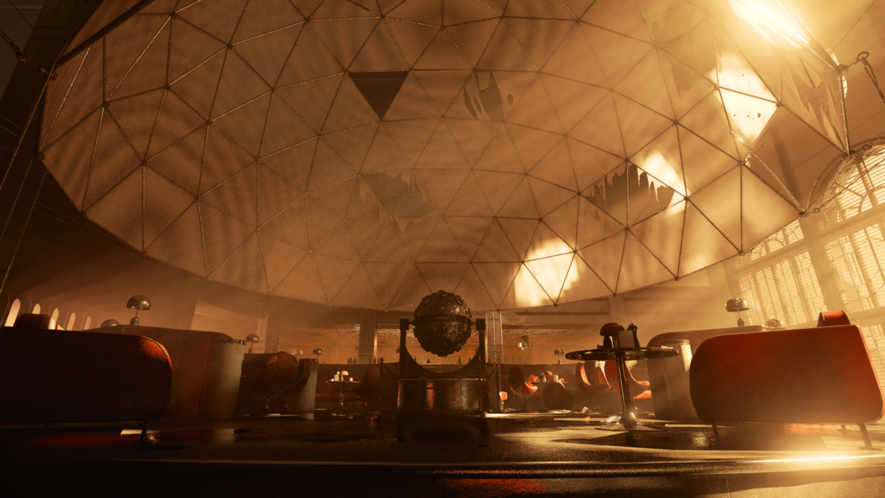
Direct sampling and AO
Notes:
This is other hard location for volume data. Look at the dome above the scene, that is made of a thin geometry.

Slide 70
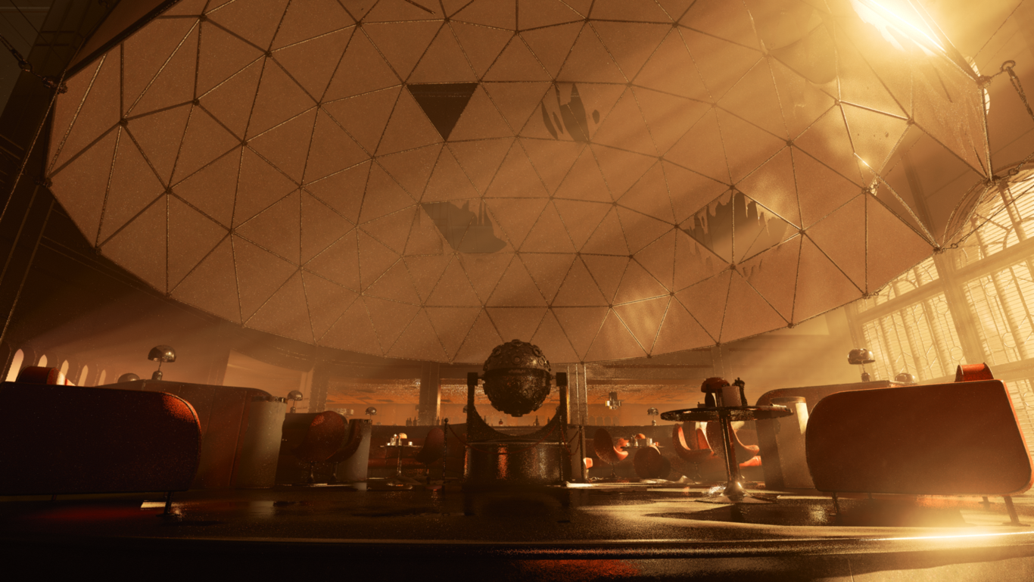
Raytraced Gather
Notes:
rt interpolation

Slide 71
Indirect Diffuse
We can also sample lighting on geometry hit
Notes:
On the previous examples, we considered rays that hit any geometry, to be black. Instead of darkening the image, we can do better, and evaluate lighting and material, like we did with reflections.

Slide 72
Indirect Diffuse
Notes:
This is the same stuff I showed you earlier.

Slide 73
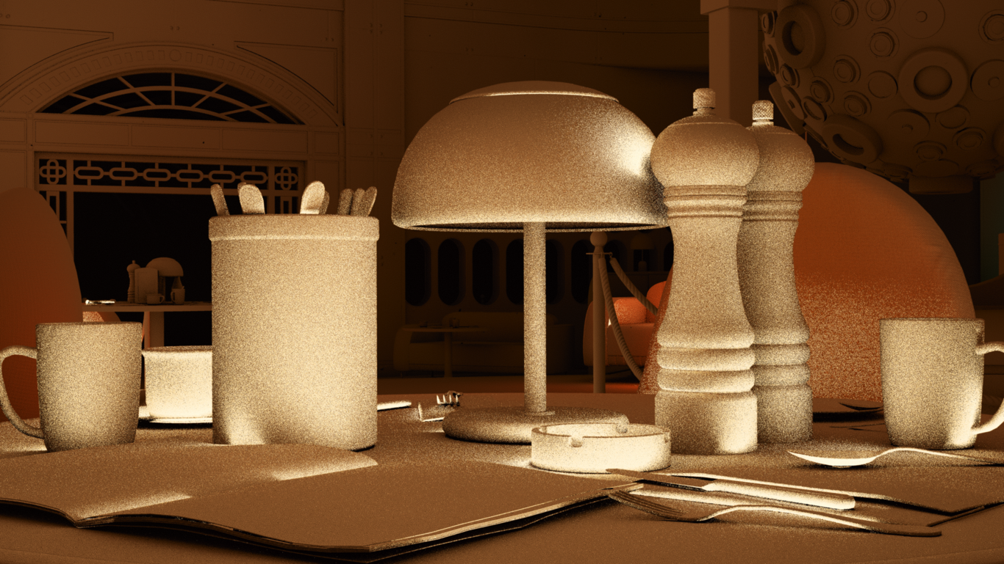
Indirect Diffuse
Notes:
And here, I have added single bounce near field global illumination. The accuracy on the first bounce, is something, that you couldn’t easily store in limited size volume. Also, the indirect lighting read from the volume, is better filtered that you could do with few rays.

Slide 74
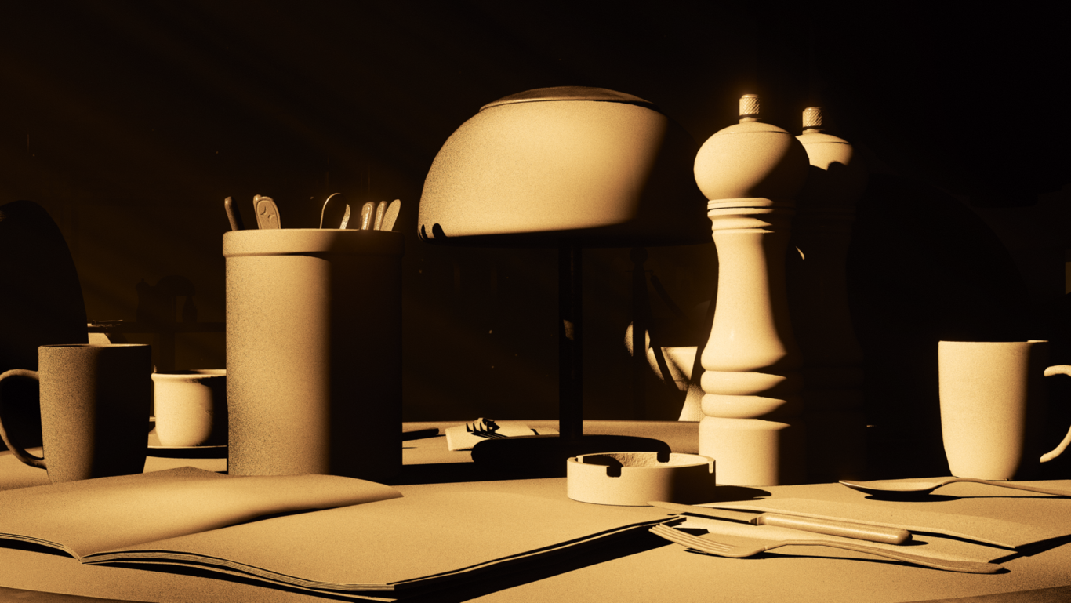
Direct lighting
Notes:
This is the direct lighting that was used for the near field.

Slide 75
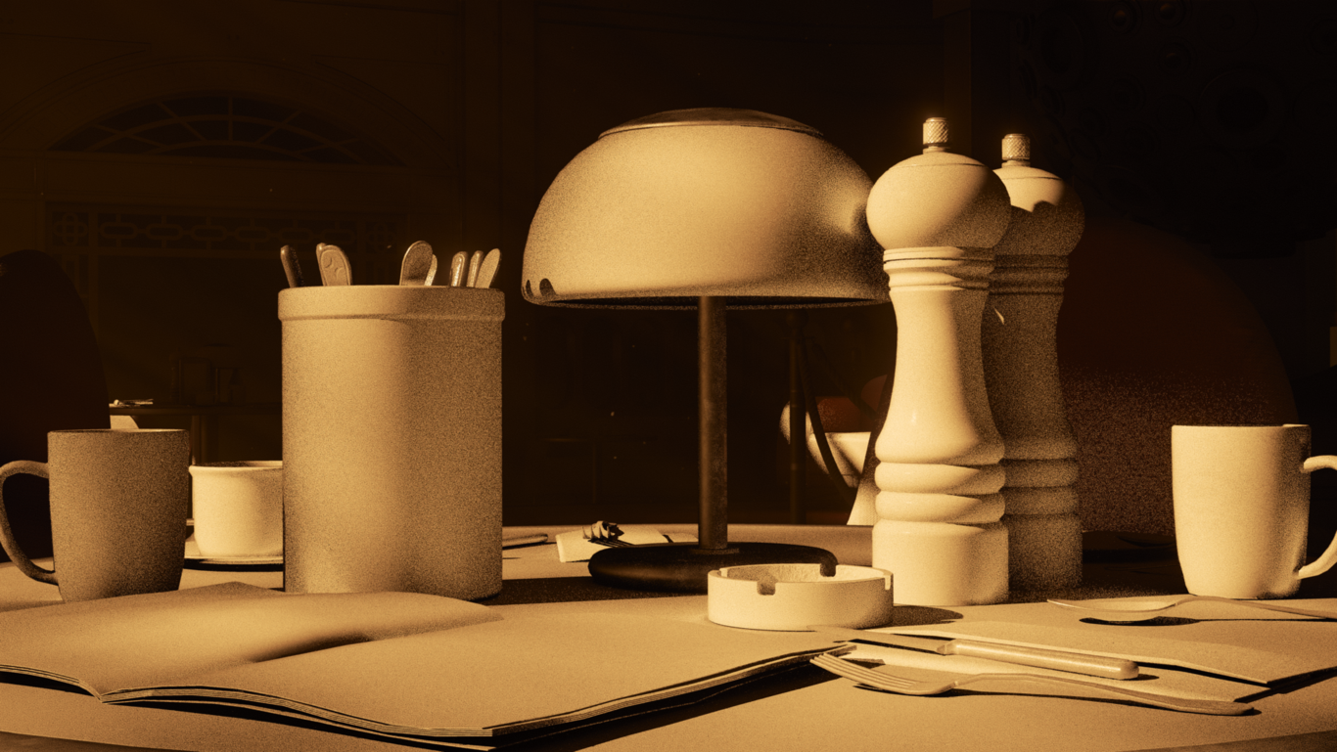
Final lighting without reflections
Notes:
This is direct lighting combined with indirect diffuse

Slide 76
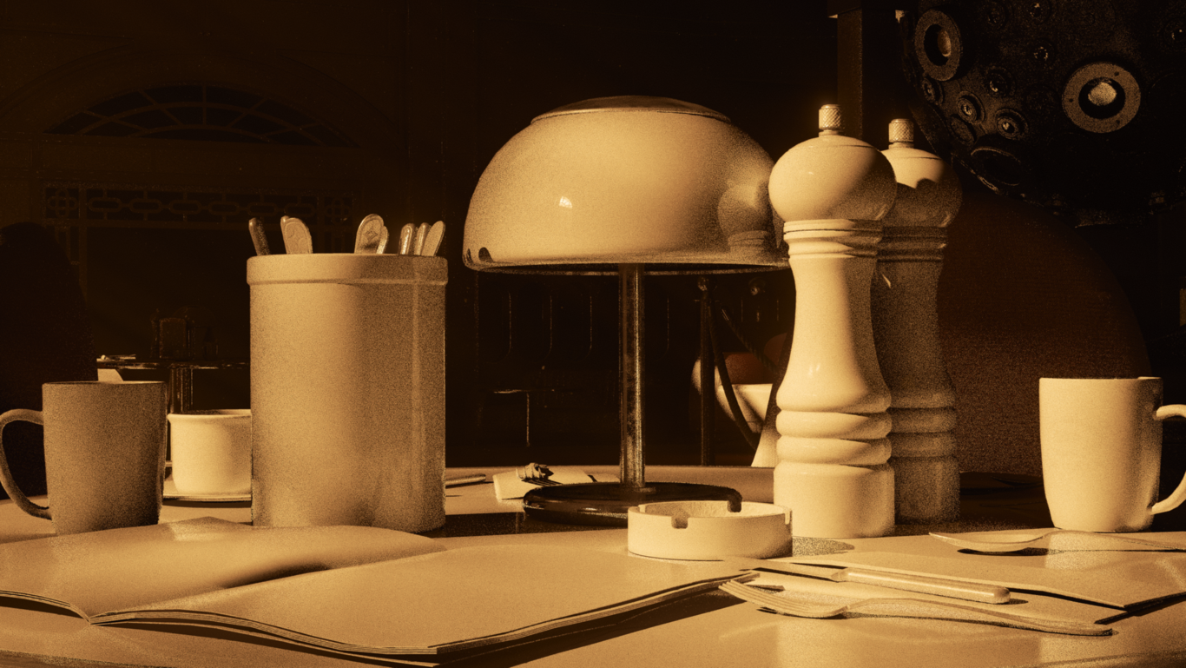
Final Lighting
Notes:
And this is final lighting with specular

Slide 77
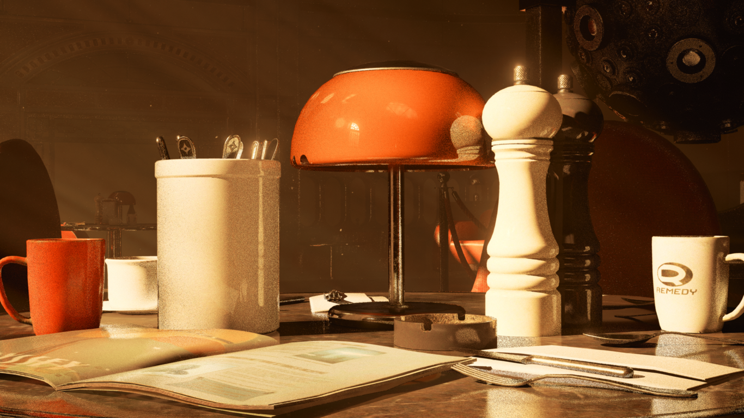
Notes:
This is the final image

Slide 78
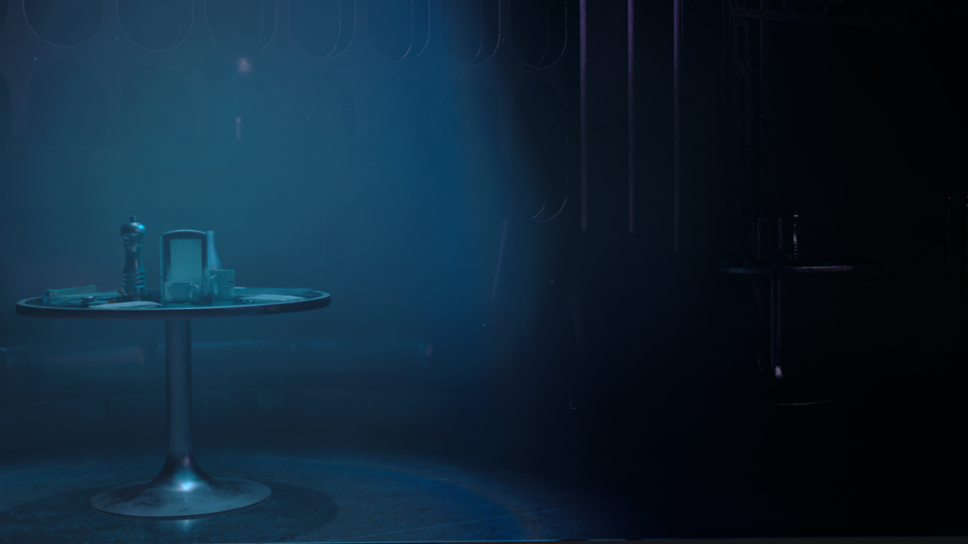
Summary
Easy access to state of the art GPU raytracing via DXR
Performance is getting there
Easy to prototype algorithms that don’t fit to rasterisation
Possible to combine with existing low frequency structures

Slide 79
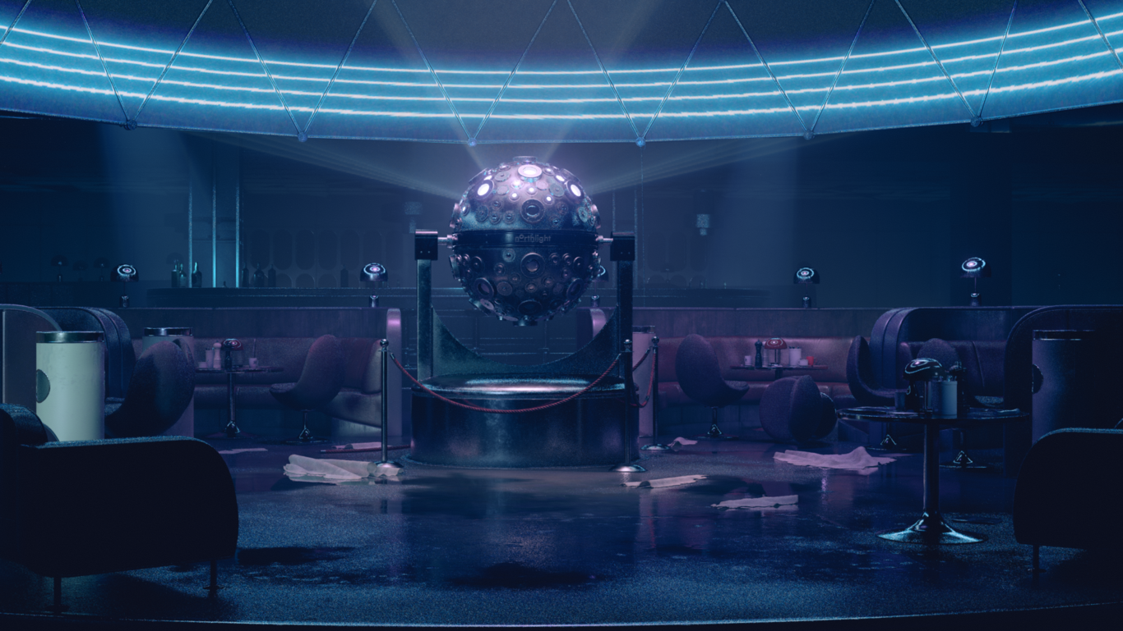
Benjamin Lindquist
Janne Pulkkinen
Juha Sjöholm (NVIDIA)
Juho Jousmäki
Pablo Fernandez
Sami Kastarinen
Stuart MacDonald
Teppo Ylitalo

Slide 80
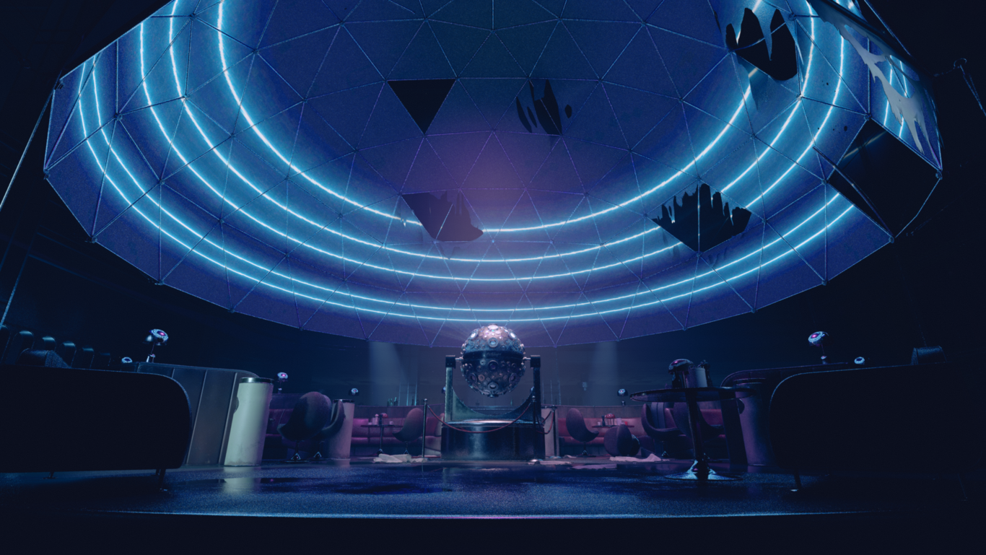
HIRING
remedygames.com/careers

